Slide 1
Site visits

Slide 2
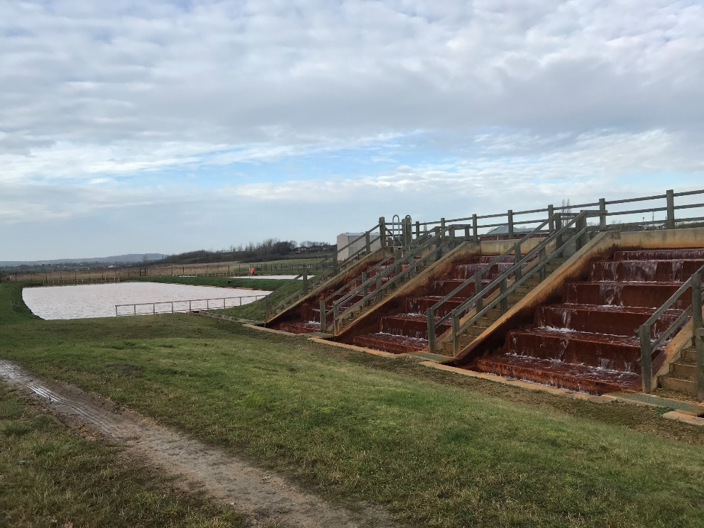
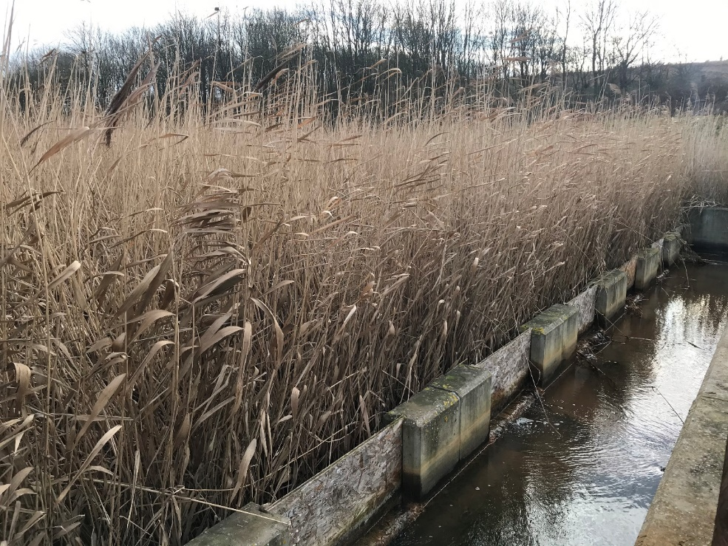
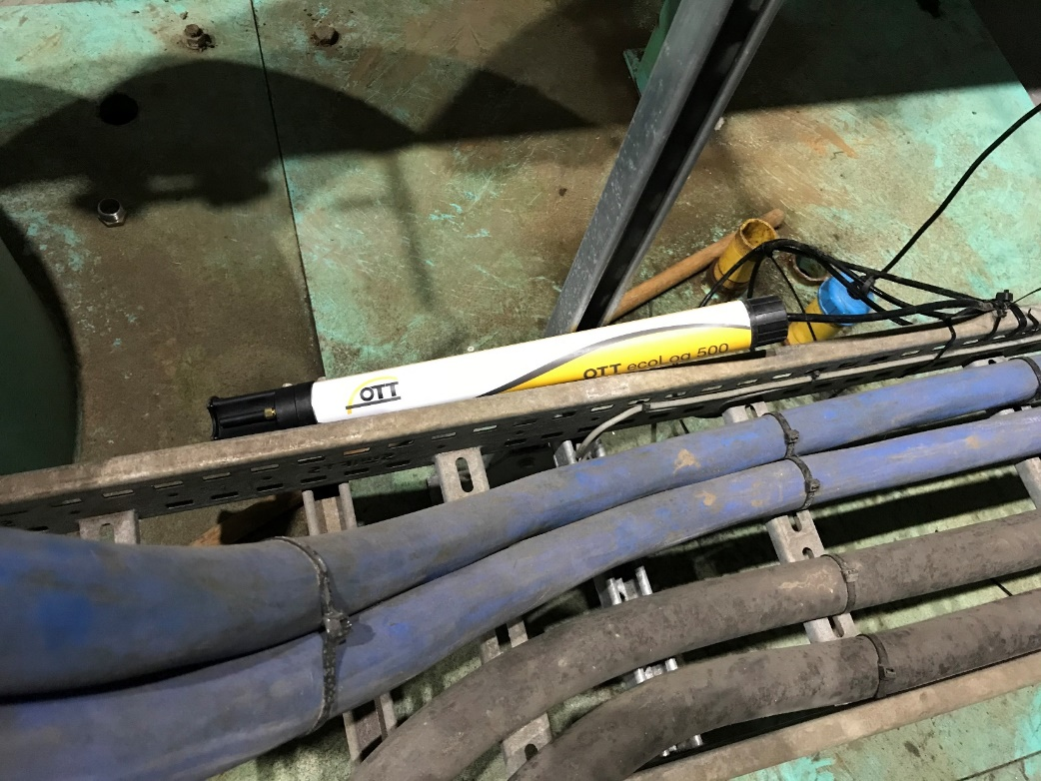
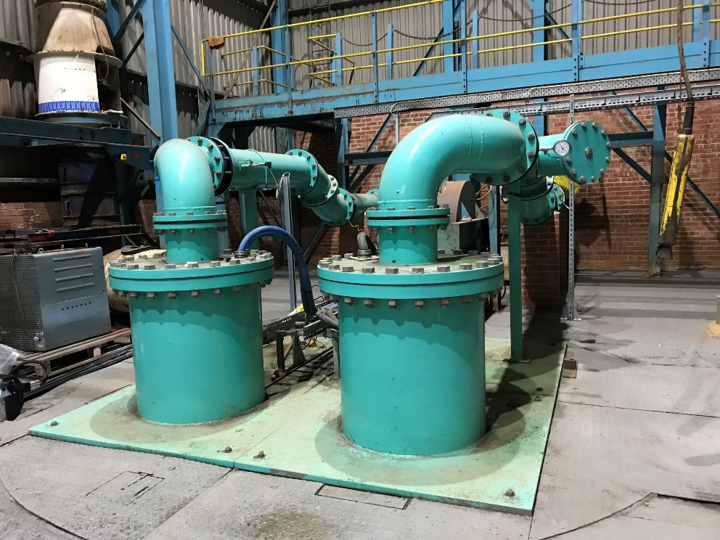
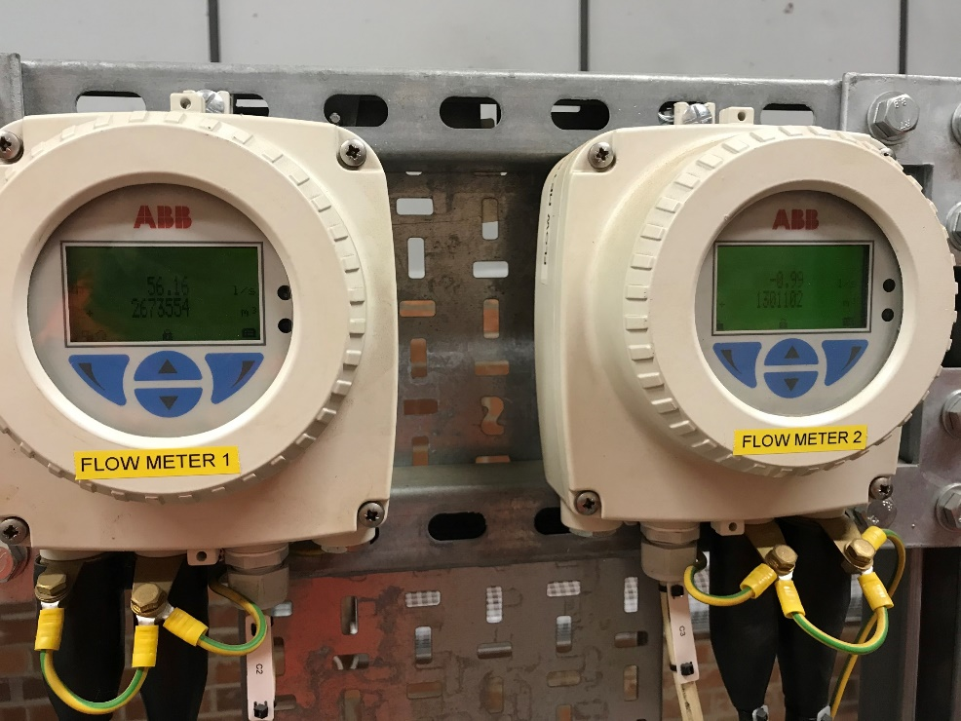
A winning treatment site

Slide 3
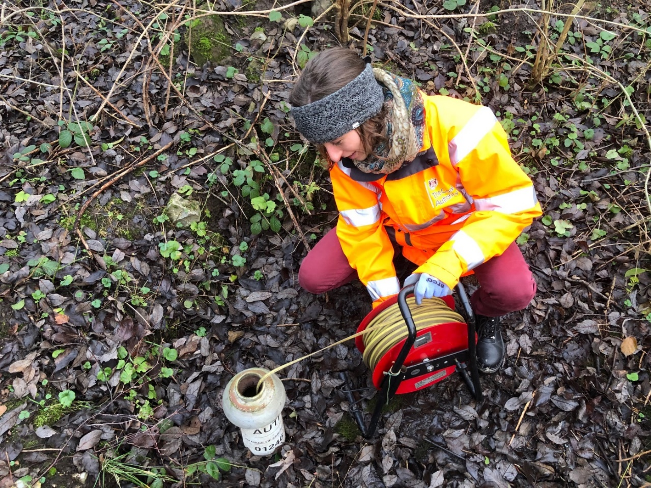
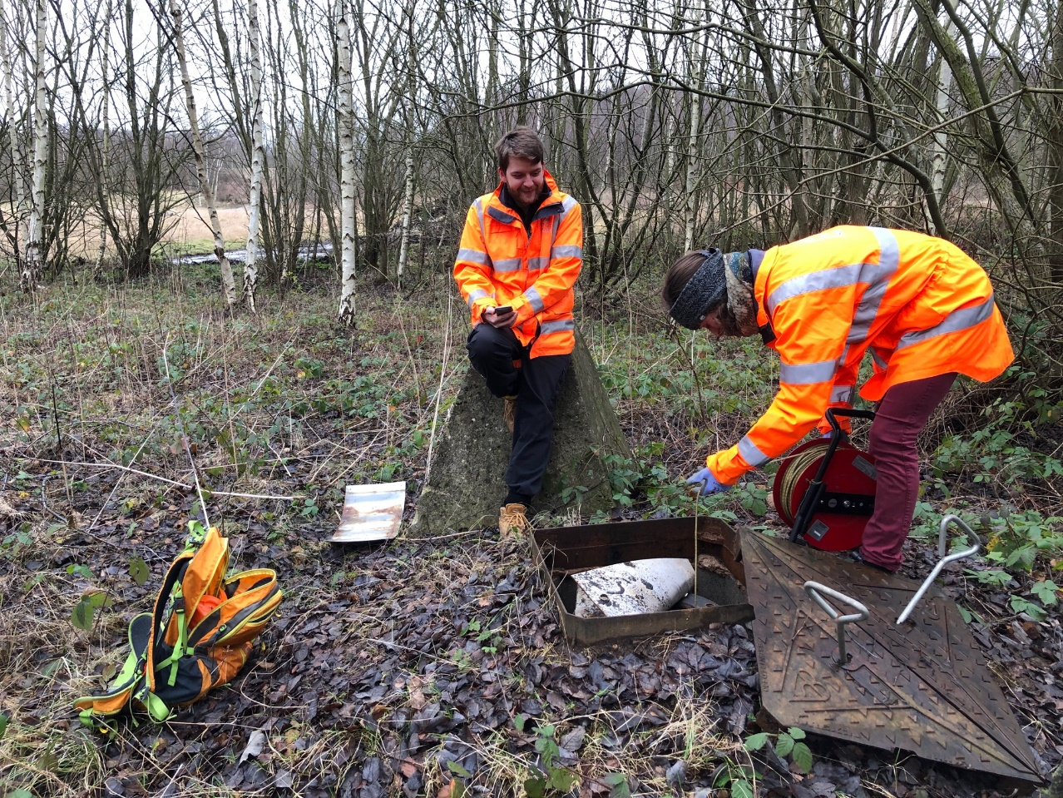
Field Work: Dipping

Slide 4
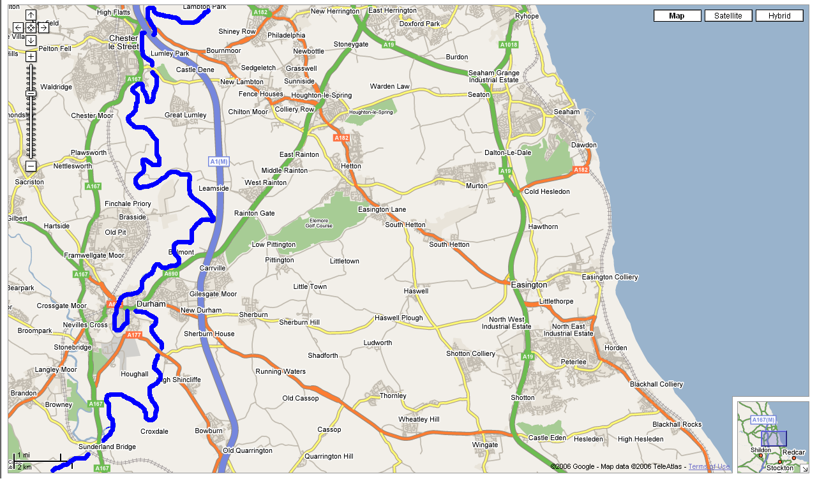
Durham area
River Wear
Minewater flow
Dawdon
Easington
Horden
Ludworth Dyke
Minewater flow

Slide 5
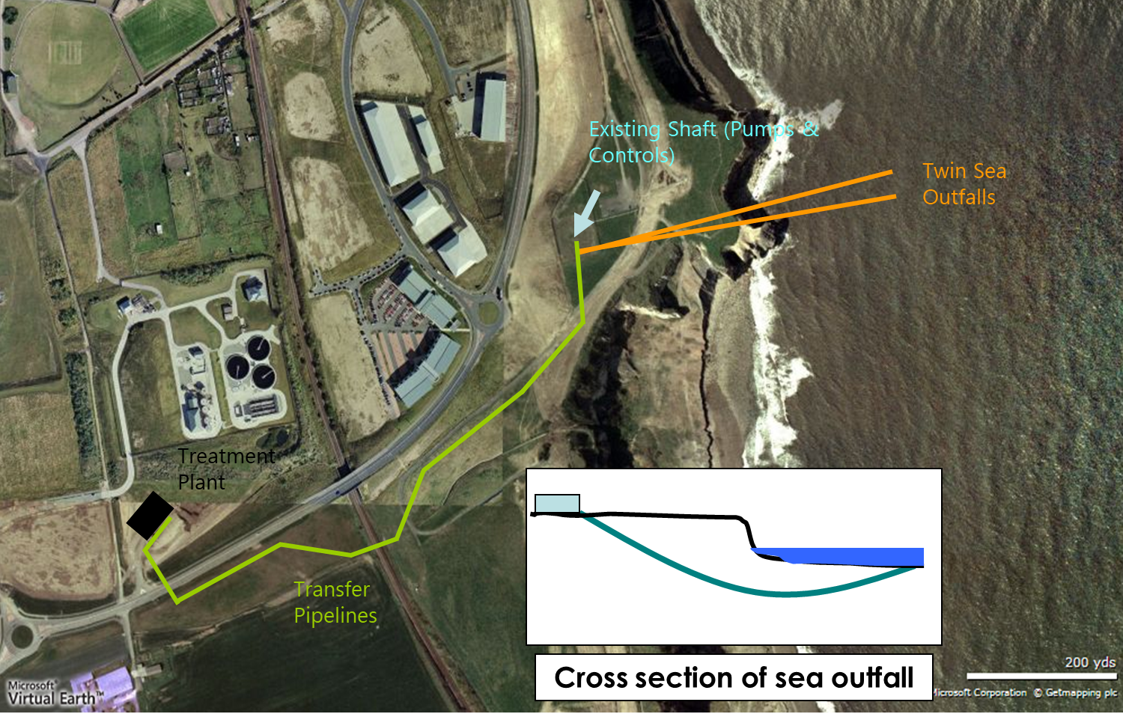
Dawdon

Slide 6
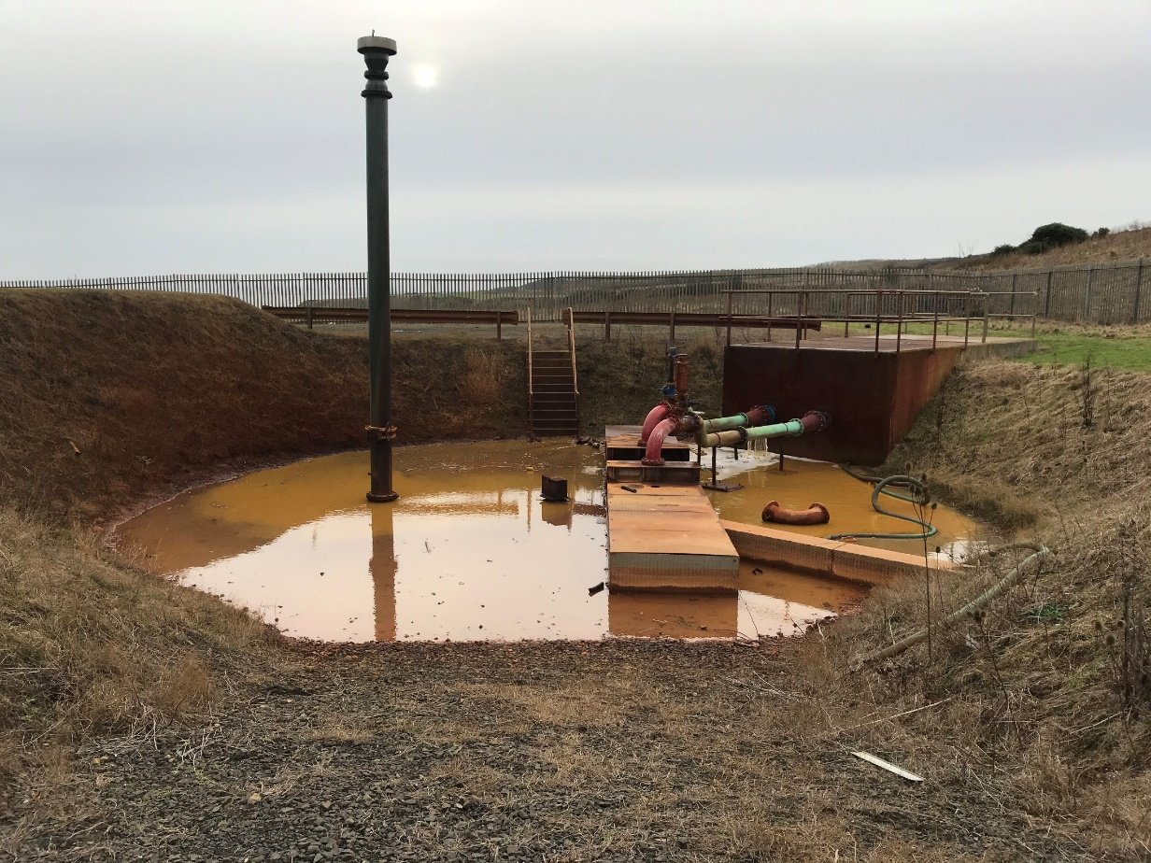
Dawdon shaft
Theresa shaft (about 300 m depth), capped but not overfilled. Water about 50 mBGL (20 mBSL)
Pumping started in 2008
Two pumps (about 100 mBGL or mBSL?) + Gas vents to allow degassing (no methane released anymore as Coal Measures are flooded).
Curved horizontal pipe is rejecting treated mine water into the sea.
20degC minewater used to heat treatment plant (heat pump).

Slide 7
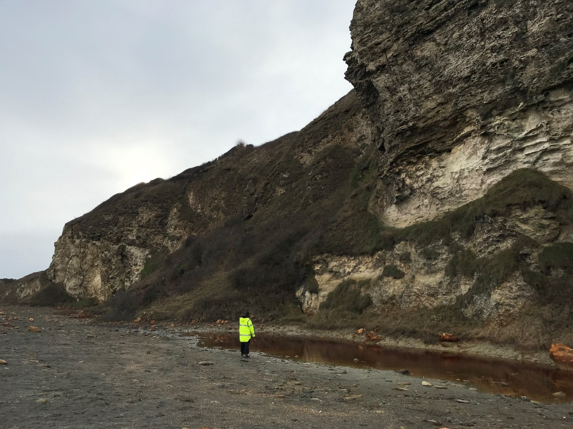

Slide 8
Dawdon treatment plant
Active treatment plant (150 L/s capacity but only pumping 80L/s) – Passive treatment with reed beds not possible due to hypersaline minewater.
Treatment scheme composed of 3 sets of 4 tanks in series, running in parallel:
1st tank: stirring for degassing 20 degC water
2nd tank (1st reactor): large iron sludge forms – pHmeter
3rd tank: (2nd reactor): increase pH by injecting limewater
Decantation ponds: forms polymer where finer iron precipitates forms and decant rapidly – reinjected into 1st reactor. Overlying sludge goes to filter press.
Clean water reinjected into ocean. About 20-25 tons of iron sludge / month?
Blower Room
Transformers, Panels and Control Room
Workshop/lab
De-Gassing Tank
De-Gassing Tank
De-Gassing Tank
Sludge Holding Tank
Sludge Holding Tank
Polymer
Make-up Area
Stage 1 Reactor
Stage 1 Reactor
Stage 1 Reactor
Lime Silo
Lime Mixing Tanks
Stage 2 Reactor
Stage 2 Reactor
Stage 2 Reactor
Process water stock
Mixed Lime Holding Tank
Outlet
Tank
Sludge Thickening and Disposal
(Filter-press)
Clarifier
Clarifier
Clarifier

Slide 9
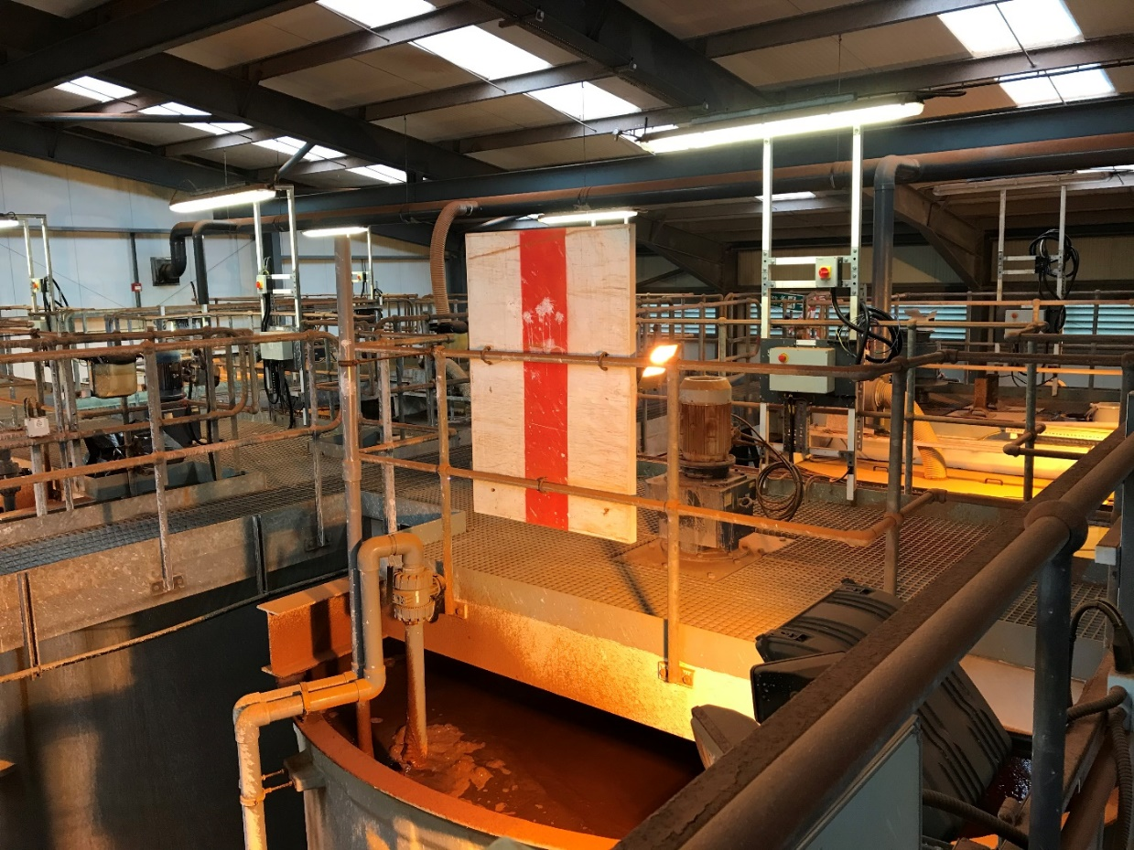
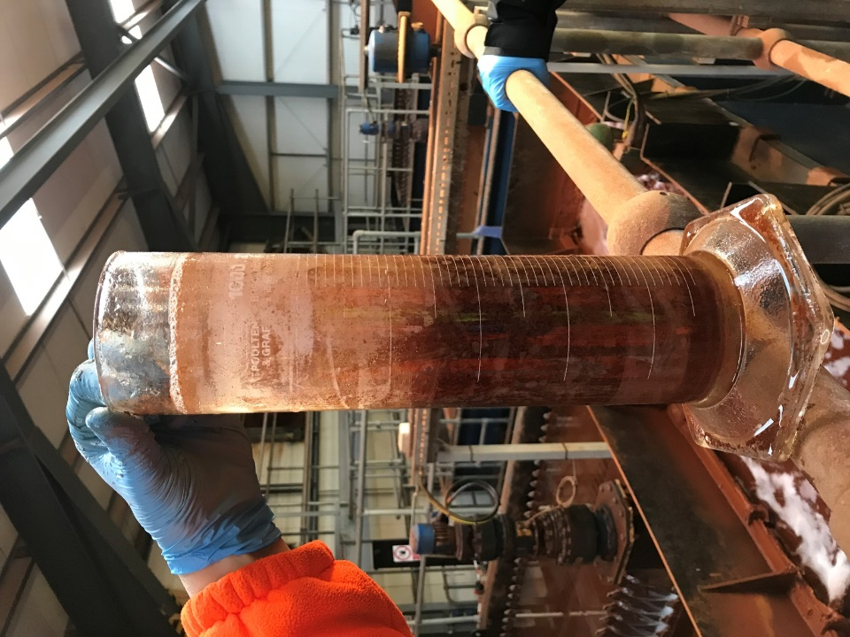

Slide 10
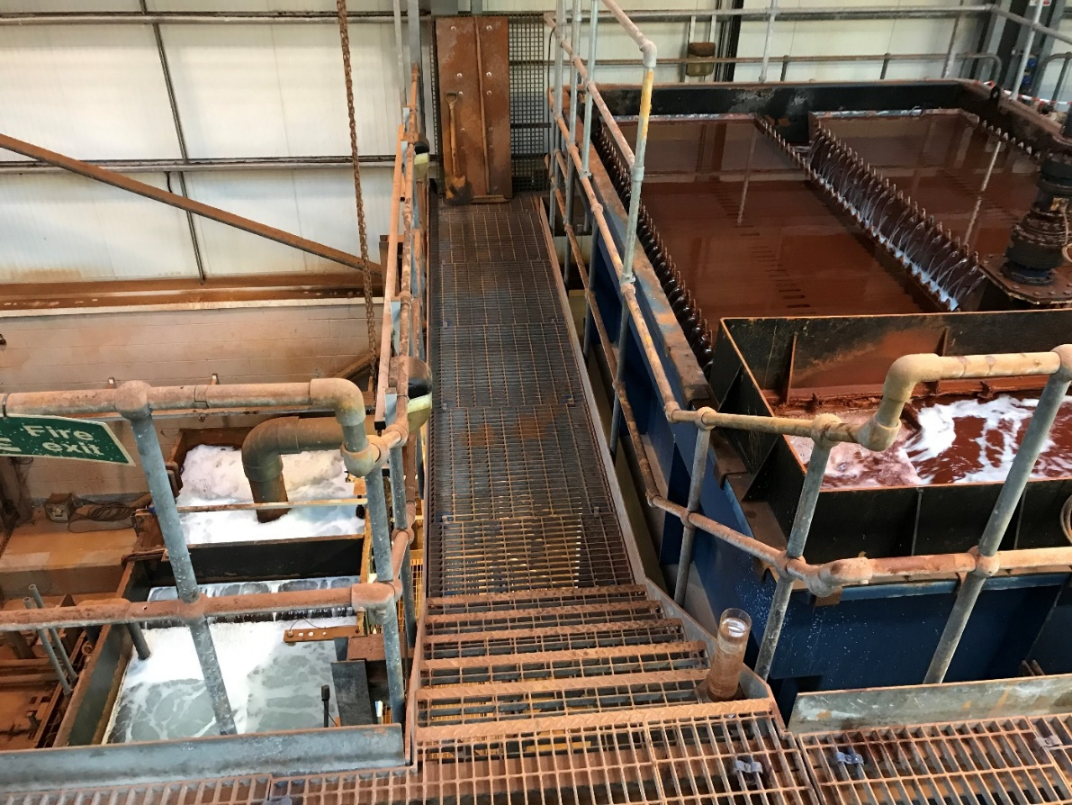

Slide 11
Dawdon treatment plant
Built in addition of the Horden facility because fault/dyke separating the mines (dammed). Opened dam might connect the two mines as pumping at Horden (from 2004) has been detected at Dawdon.
Pumping commenced August 2004

Slide 12
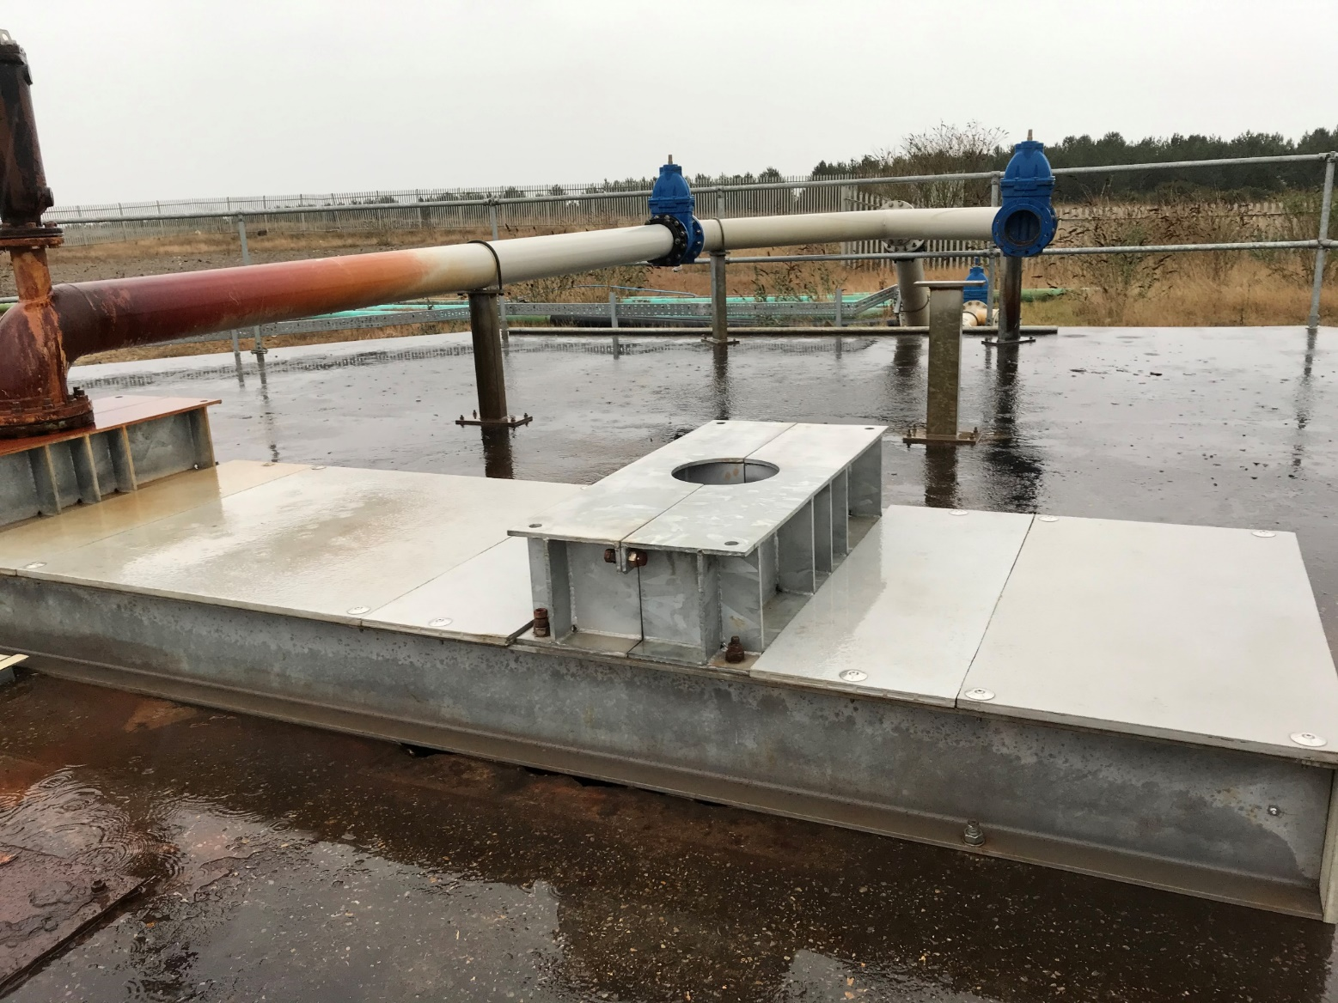
Horden
Horden shaft – shallower than at Dawdon.
Only one pump
Reinject water into the sea using similar curved pipe.
Pumping started in 2004 (active plant)
Quality of water decrease if pumped harder (salinity and Fe increase)

Slide 13
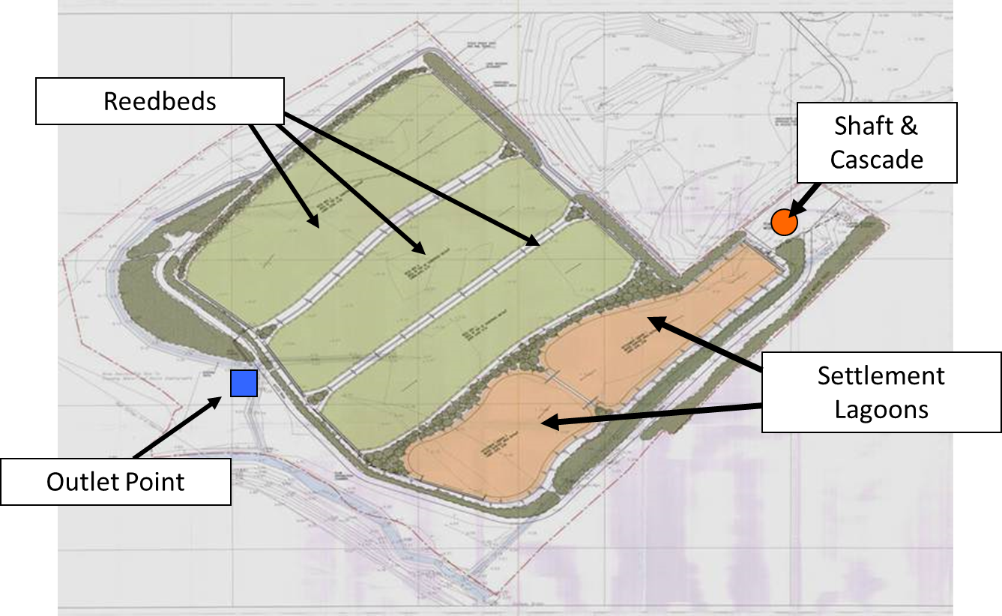
Horden
Originally a temporary active treatment plant (100 – 50 L/s) replaced by a passive treatment plant (capacity 50 L/s) in 2011 after Dawdon started.
2 settlement lagoons in parallel, 2 reed beds in series
Small reed beds due to salinity of water – not well developed in second reed bed as used with original plant (higher salinity).
Calcite precipitate in cascade?

Slide 14
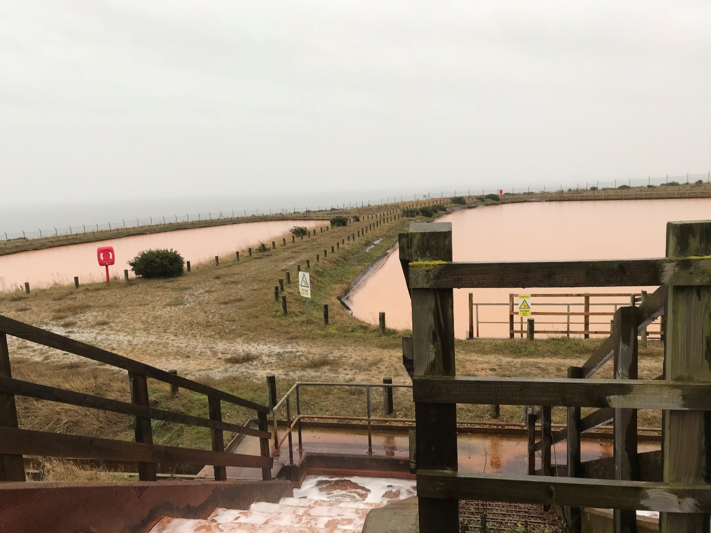
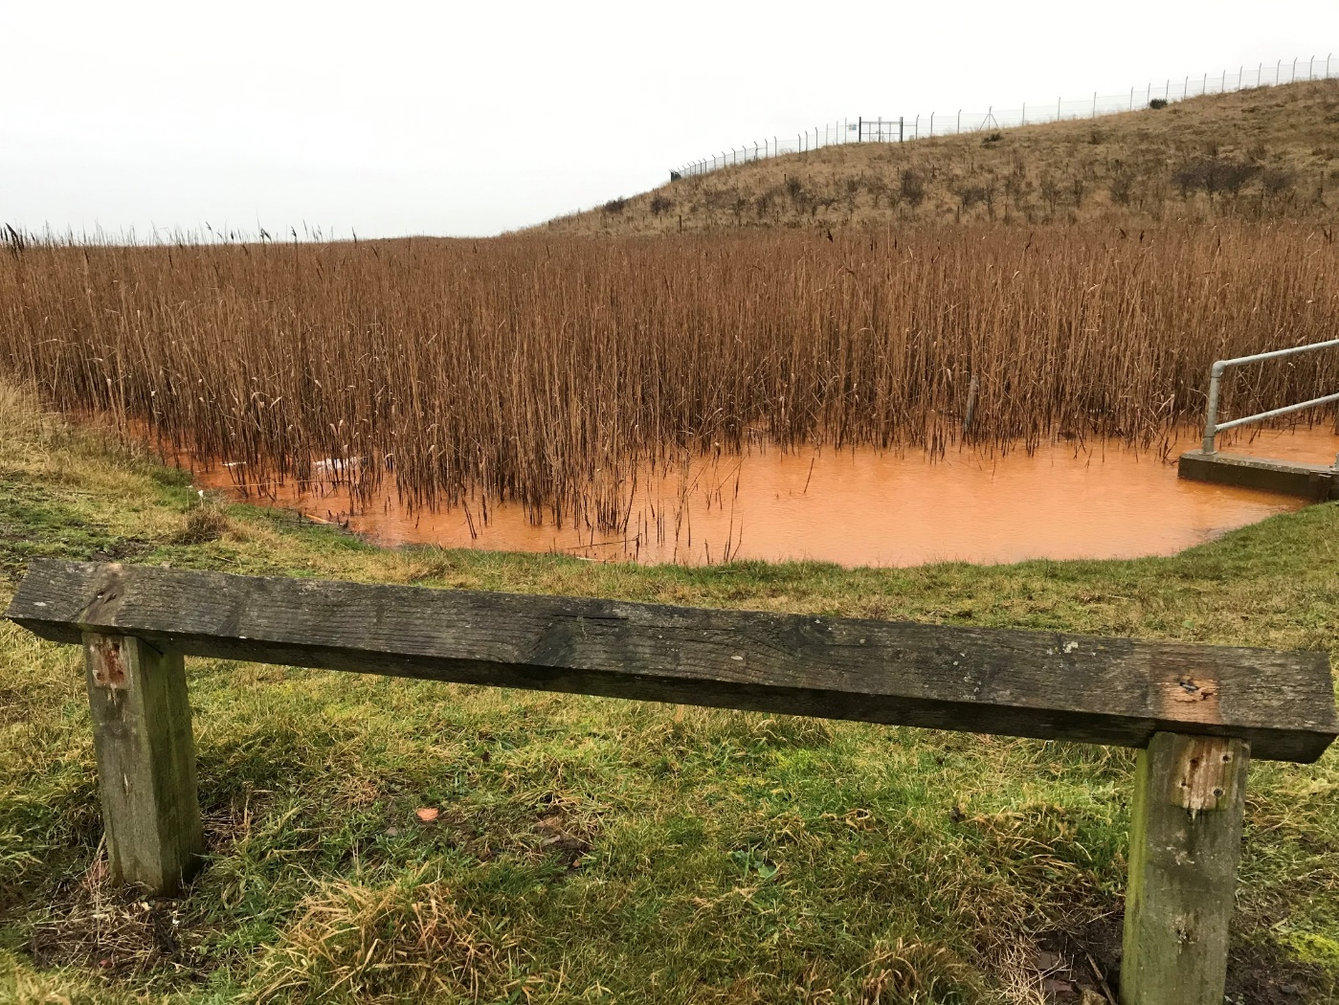
Horden

Slide 15
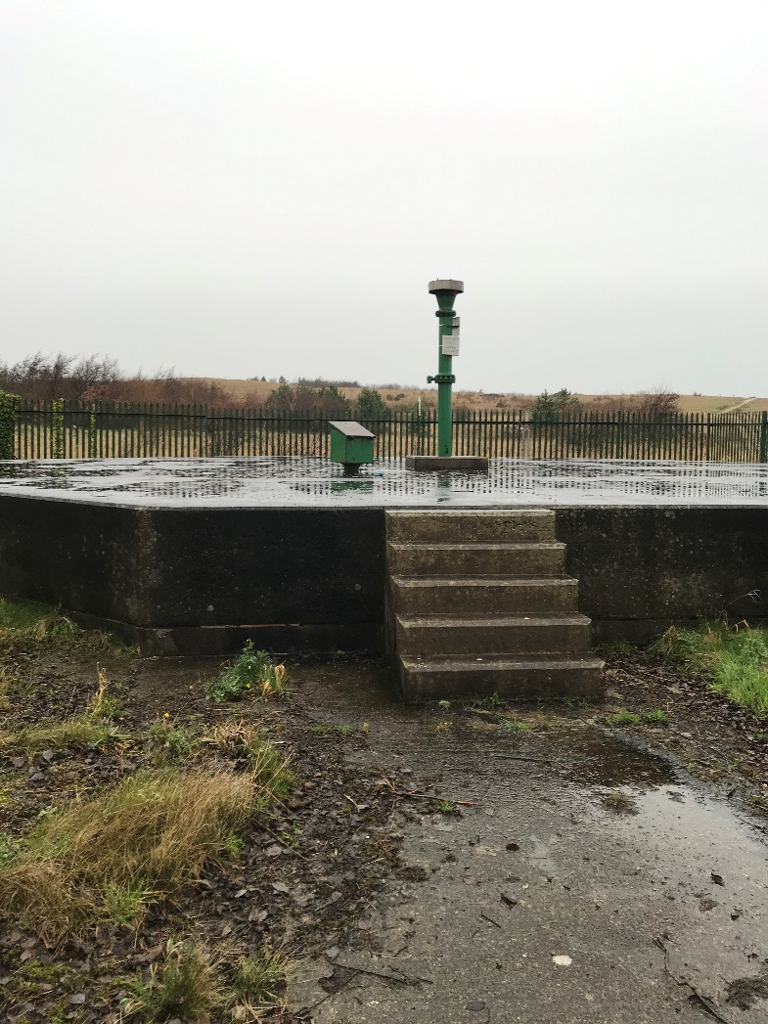
Easington

Slide 16
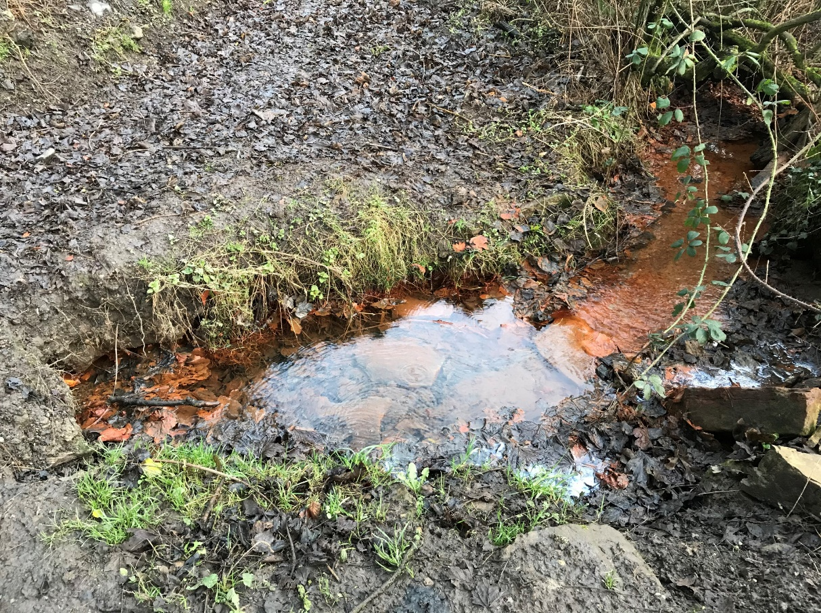
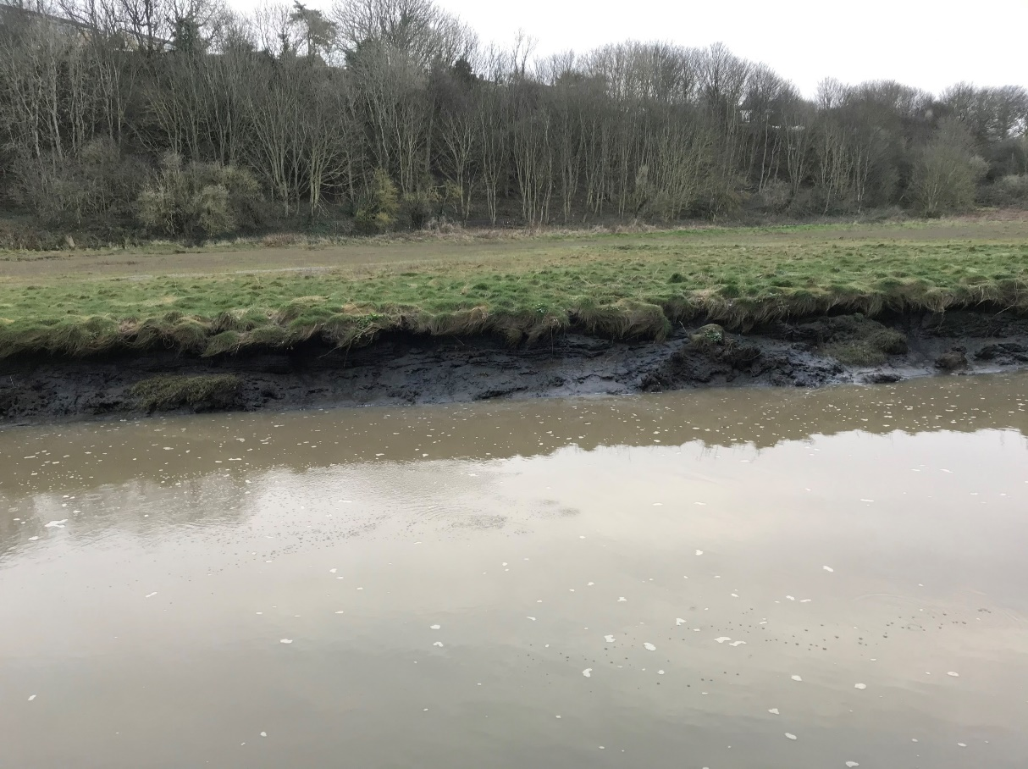
Seaton Sluice upwelling
Underlying workings (Bates area)
Adit connects to the river

Slide 17
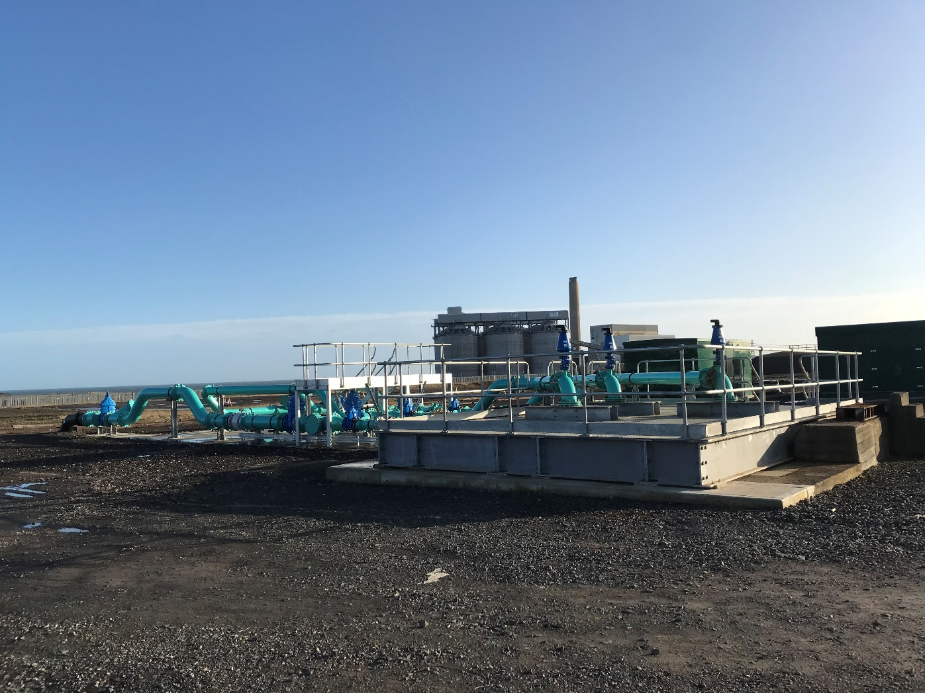
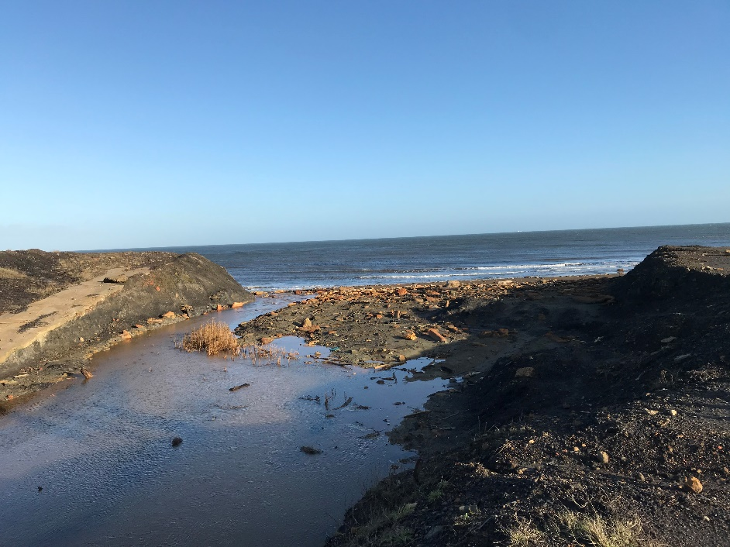
Lynemouth
Composed of two phases:
Phase 1: two lagoons in series
Phase 2: two series of 3 and 2 lagoons running in parallel.
Both discharged to the sea

Slide 18
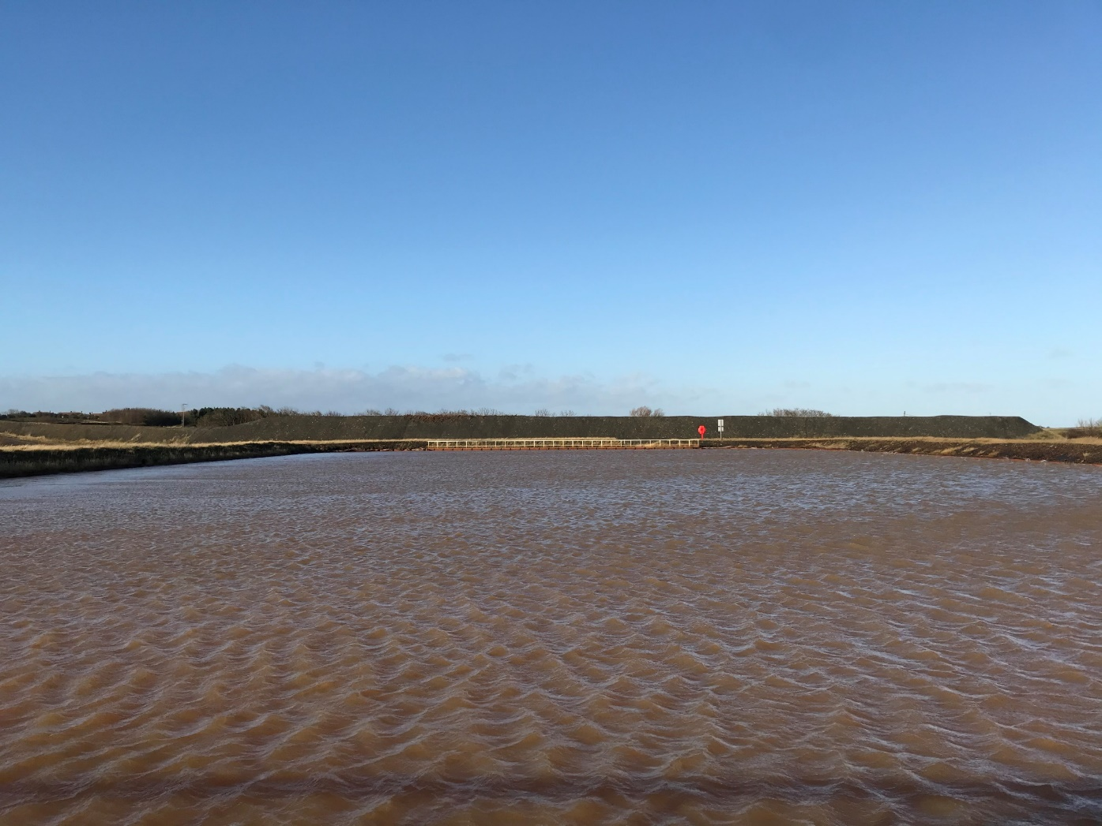
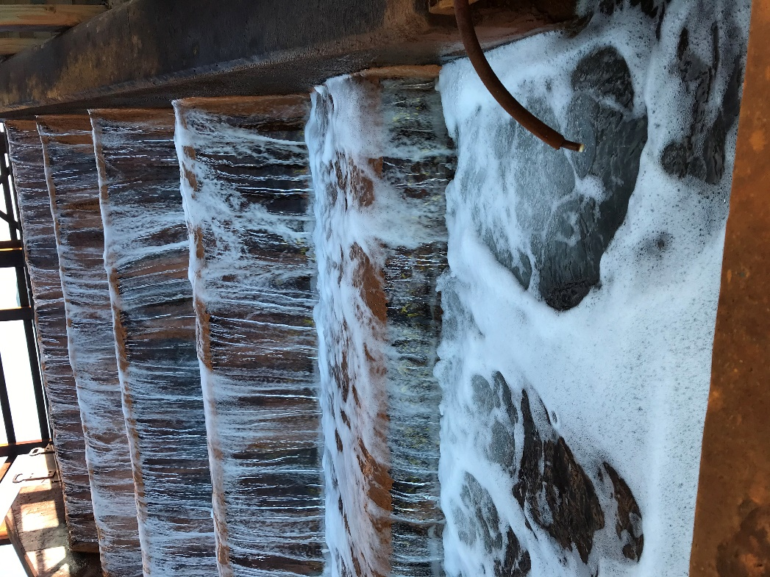
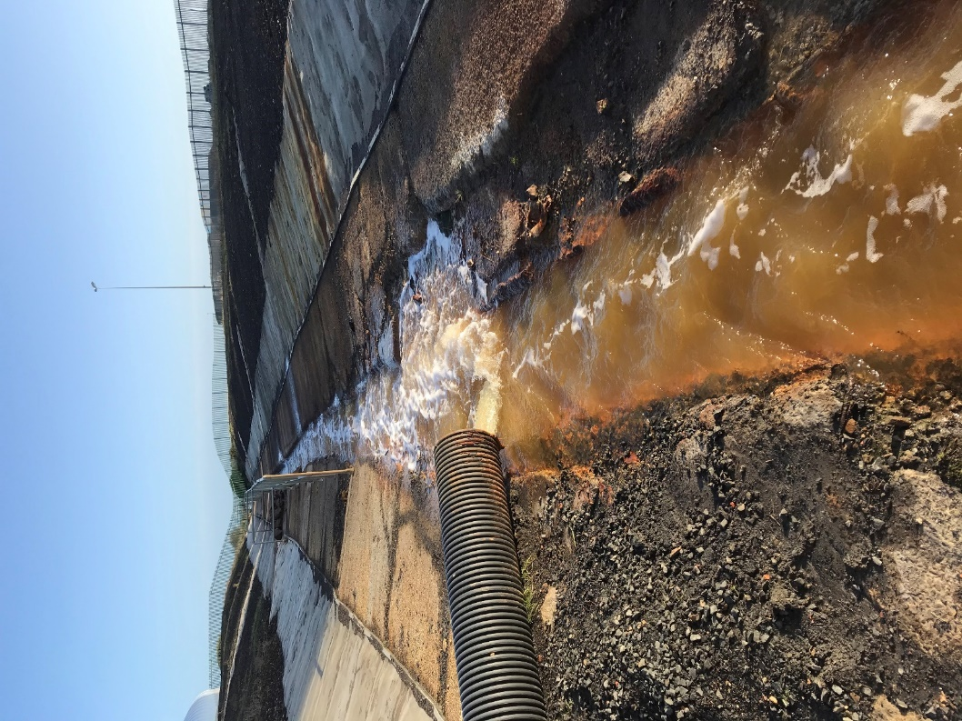
Lynemouth - Phase 1

Slide 19
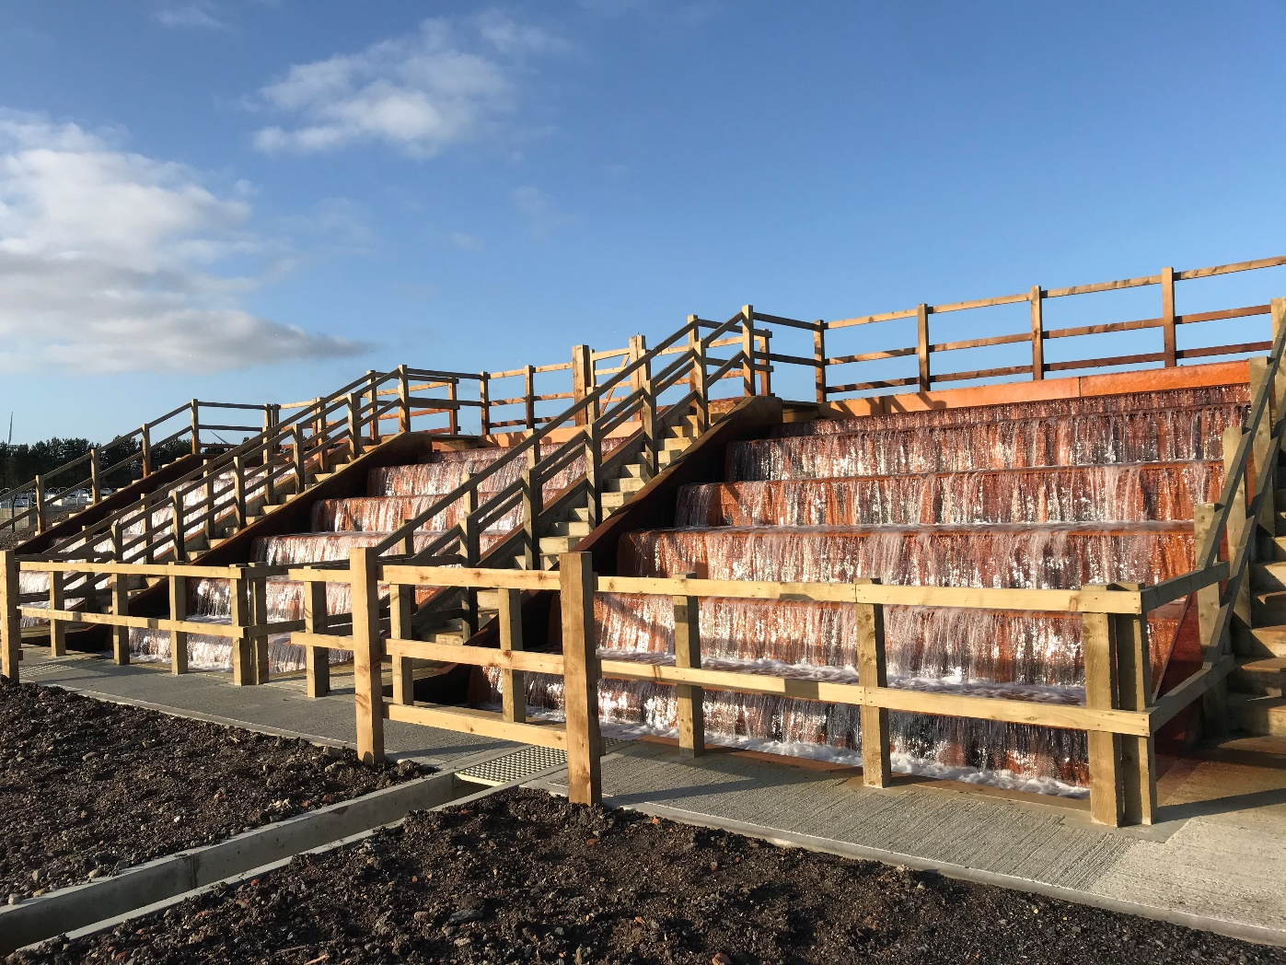
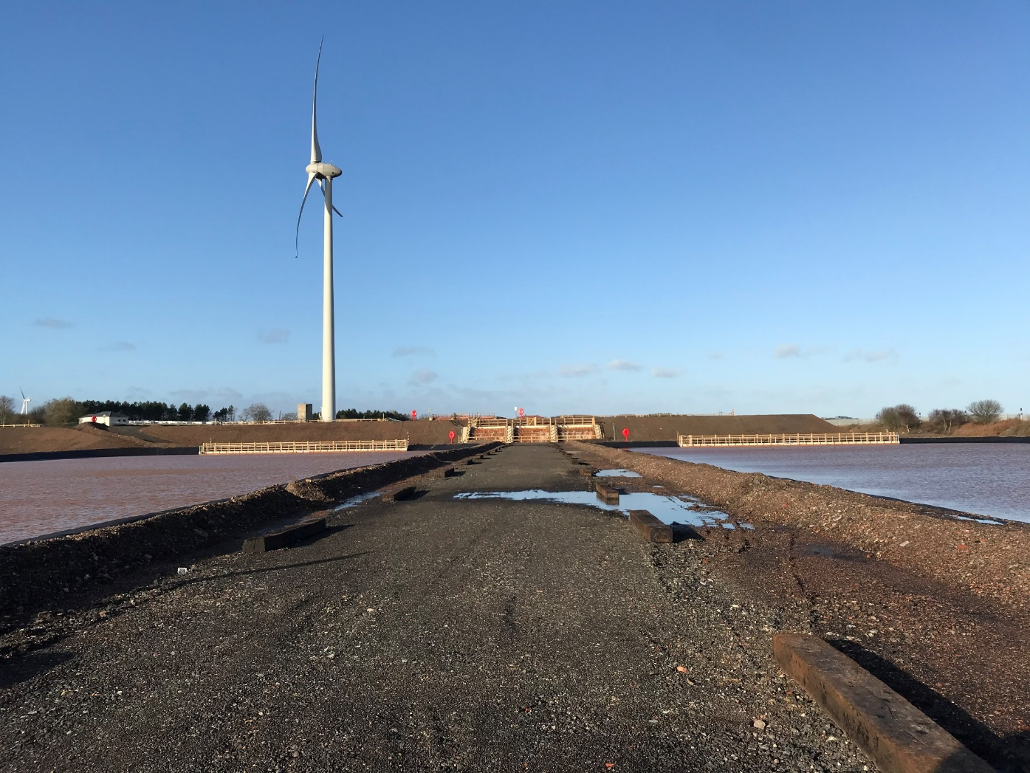
Lynemouth - Phase 2

Slide 20
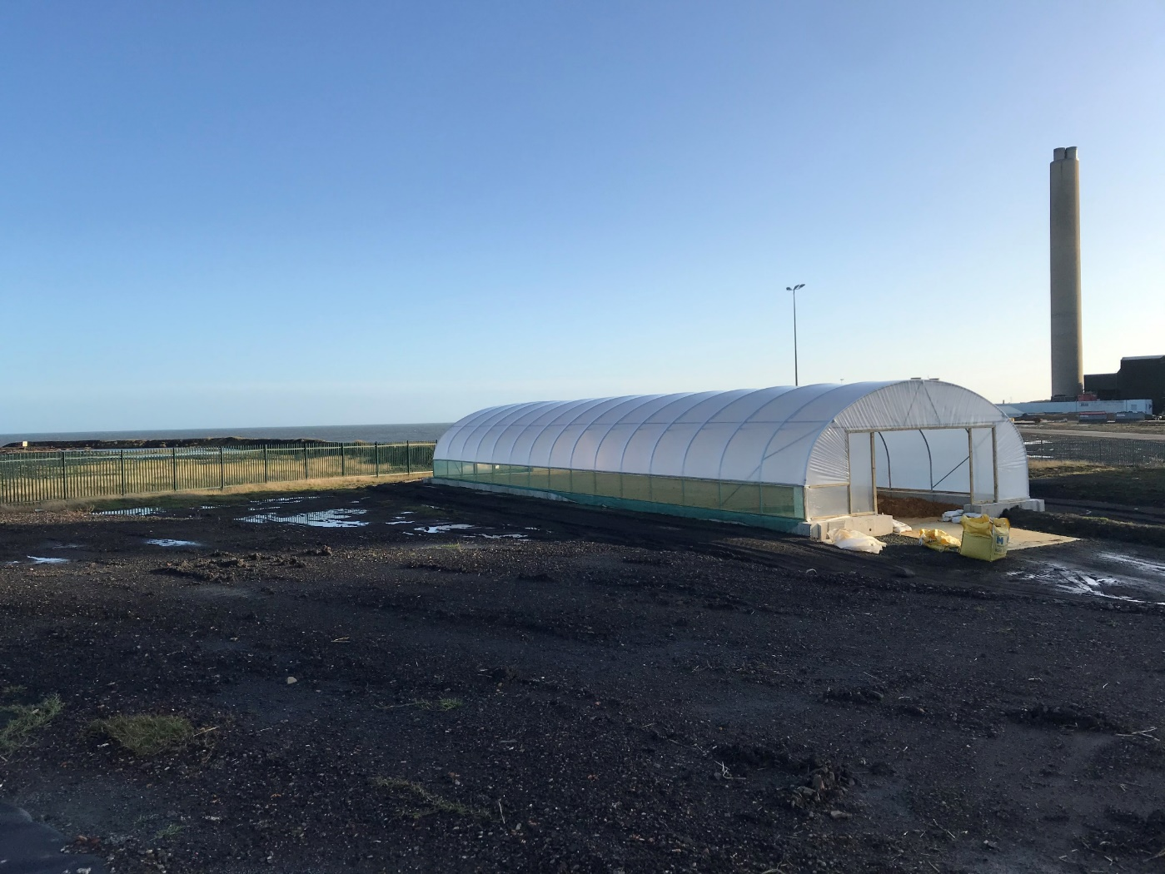
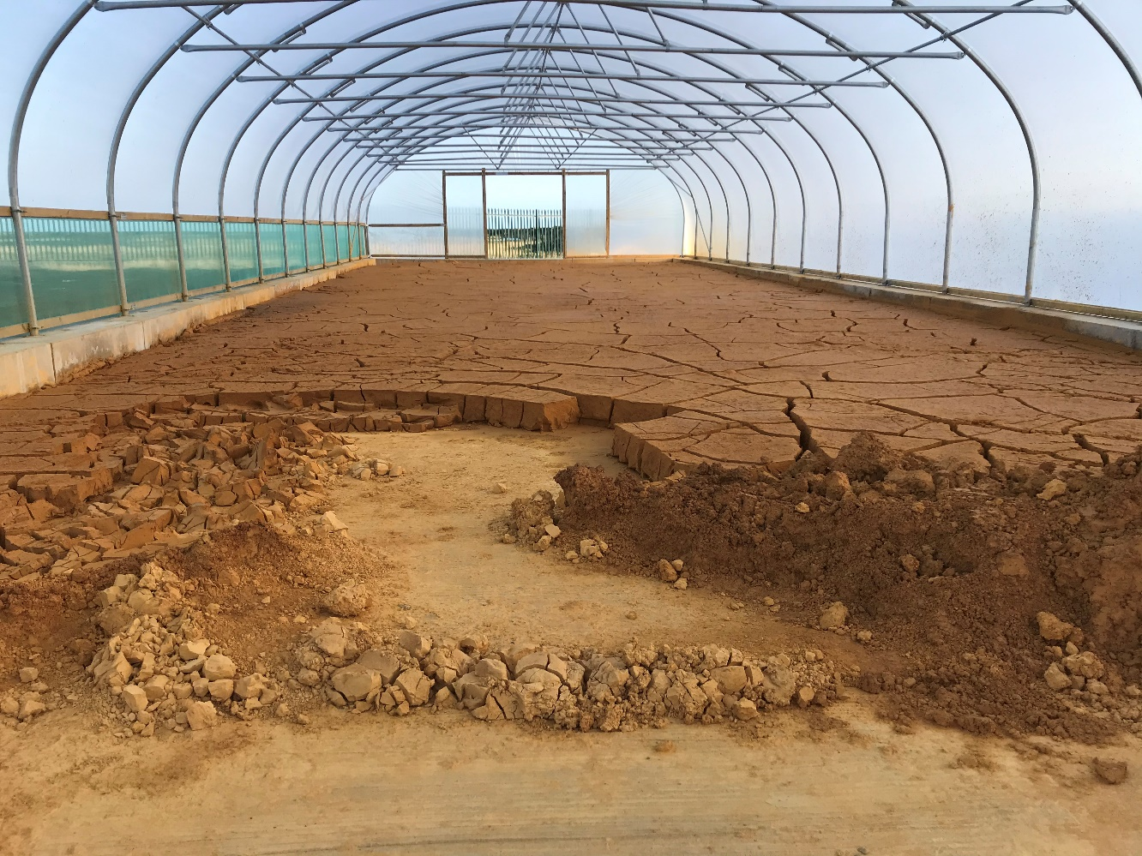
Lynemouth
‘Greenhouse’ dry ochre

Slide 21
Meeting report
Modeling
Start with simple models to identify which features of the mines are important to determine the temperature of water when reaches the abstraction point :
mine shafts / roadways / longwall panels
vertical/lateral geometry, volume of workings, presence of diping coal seams bringing water down from surface
depth of production…
When looking at mine plans, identify:
Are workings well connected to main flow path?
Connection between mines
Connection between seams
Type of model:
2D models – steady state model – ??
Simulation of heat extraction
Identification of zone of influence
At what rate water is cooling down at the surface / heating when going down?
Notes:
Shallow workings are the wettest (recharge from rainfall), deeper seams doesn’t not respond as much from rainfall so less inflow

Slide 22
Long – term objectives
Bilston Glen
Simple 2D model of Bilston Glen
How can existing digital GIS data be used in the model?
What are the limitation of the available data?
Identify flow path from mine plans and make sure that they are represented in the simulations
Are lateral panels around roadways important?
Dawdon
Mine flooded in 10-15 years
Pumped water temperature 20C since 11 years at a rate of 80 L/s
Which water flooded the mine?
5 T-depth profiles from dawdon/harden before/after pumping
Data required:
Data about rock temperature in the mine (historical data to plan ventilation)
Temperature profile in borehole/wells (no turbulent flow)

